Slide 1
Generative Models and Fooling Neural Nets
CMPUT328 (Visual Recognition)
Nilanjan Ray

Slide 2
Agenda
We will study a special type of autoencoder called “Variational Autoencoder” that are able to generate images.
We will study Generative Adversarial Nets (GANs), which forms the state-of-the-art generative models for images today!
We will also look at how to fool a neural network – called adversarial attacks.

Slide 3
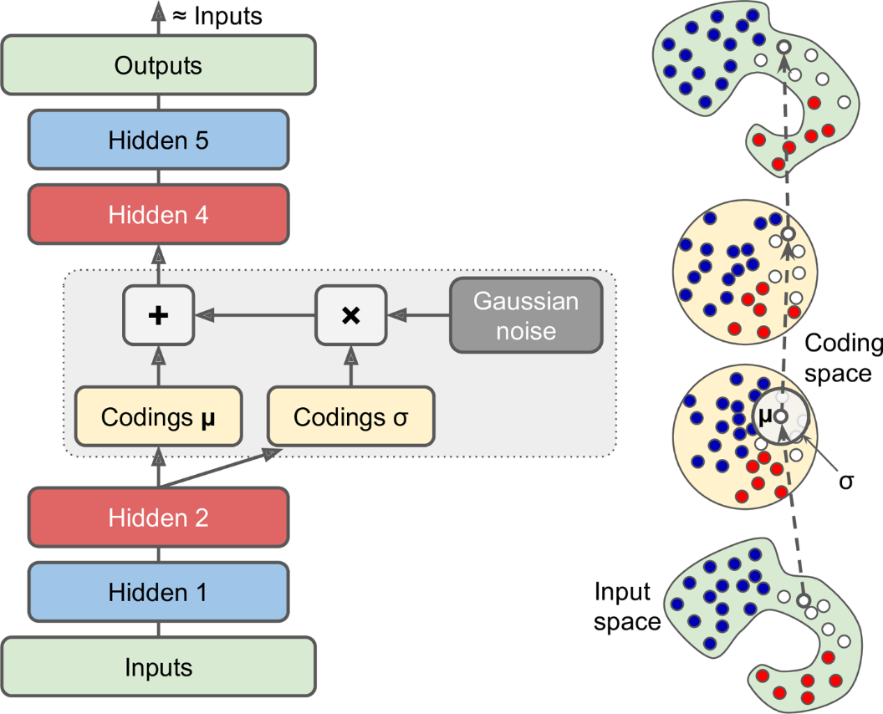
Variational AE
Cost function has two components:
Reconstruction + constraint for μ and σ
The constraint: the encoded distribution
should look like a zero-mean, unit variance
Gaussian.
The advantage is that you can generate
data (images) that look like the training
images.
https://towardsdatascience.com/intuitively-understanding-variational-autoencoders-1bfe67eb5daf

Slide 4
Generative Adversarial Nets: Resources
http://cs231n.stanford.edu/
https://lilianweng.github.io/lil-log/2017/08/20/from-GAN-to-WGAN.html
https://pytorch.org/tutorials/beginner/dcgan_faces_tutorial.html
https://www.kaggle.com/jessicali9530/celeba-dataset

Slide 5
Fooling LeNet
Simple tricks can easily fool a neural net!
We will modify some pixels in a digit image (say 7) to make LeNet to think it is another digit (say 3).
We will refine our solutions.
Finally, we will have an image with random numbers (close to it) to fool LeNet think that it is a digit with very high probability.

